Slide 1
Why Delaware: The First State v. Other States
The Delaware Trust Conference – Wednesday, Oct 23, 2019, 3:30-4:30
Jeff Wolken Todd Flubacher
Wilmington Trust, N.A. Morris, Nichols, Arsht & Tunnell LLP
National Director of Fiduciary Strategies Partner

Slide 2
Delaware: The First State (for Trust Innovation)
It was the first state to pioneer many innovative trust laws:
Delaware created the “directed trust” early in the twentieth century
Delaware pioneered the “perpetual“ trust through the use of limited powers of appointment to extend the perpetuities period at each generation
Delaware enacted the prudent investor rule in 1986, several years before the 1994 promulgation of the Uniform Prudent Investor Act (UPIA)
In 2001, Delaware became the first state to enact a total return unitrust- conversion statute
Delaware’s Supreme Court and its Court of Chancery have rendered many of the country’s early trust decisions and a number of key trust decisions in more recent years
In 2016, Delaware adopted the lowest premium tax rate in the United States— 0%— for large private-placement life-insurance policies

Slide 3
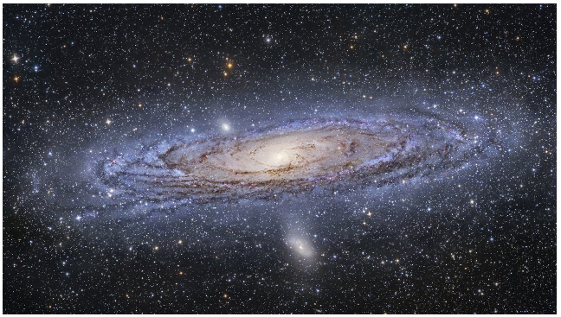
Our Universe

Slide 4
Our Universe
Delaware

Slide 5
Impact of Trust Industry on Delaware’s Economy
Conservative estimate – trusts contribute $300 million in fiduciary fees annually
10-20 times trust assets and fiduciary fees expected for a state of comparable size
Conservative estimate of 2-3.5x multiplier to calculate contribution to Delaware’s economy
Delaware‘s trust industry has grown substantially in the past two decades

Slide 6
Ranking the States Separating Fact From Fiction

Slide 7
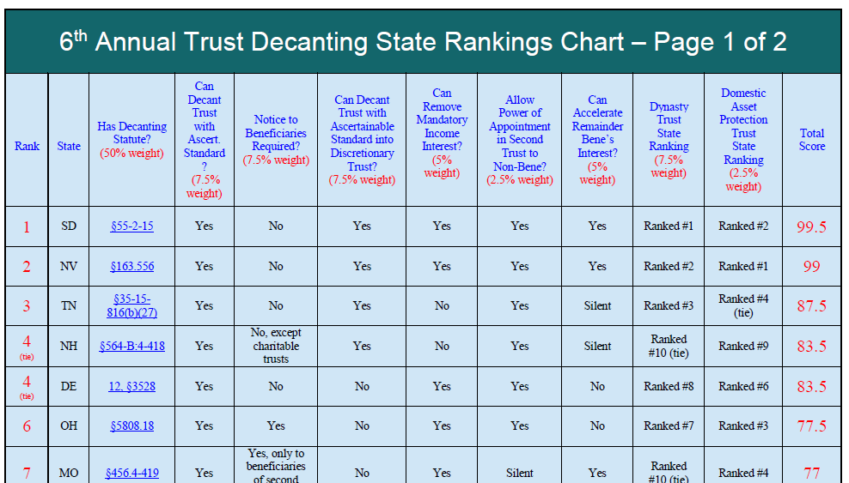

Slide 8
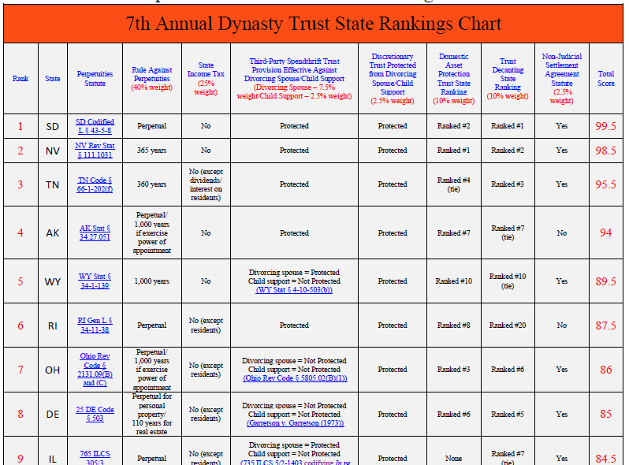

Slide 9
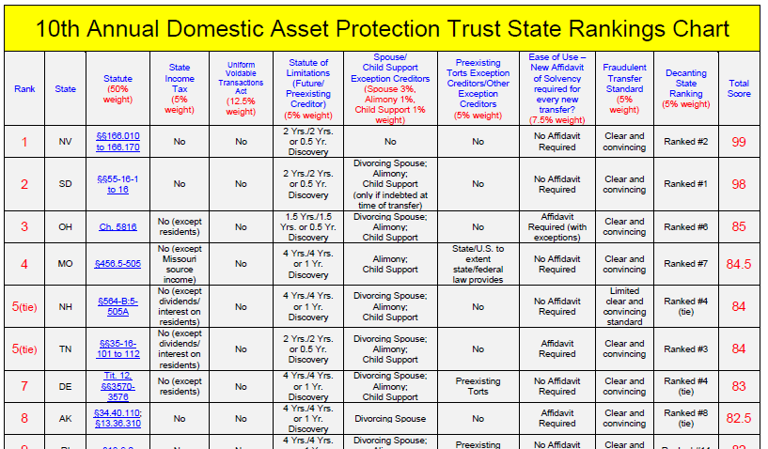

Slide 10
Home State Competition for Trusts
Proliferation of Uniform Acts
Uniform Trust Code
Uniform Directed Trust Act
Uniform Prudent Investor Act
Uniform Trust Decanting Act

Slide 11
Home State Competition for Trusts
Proliferation of Domestic Asset Protection Trusts
17 States allow self-settled spendthrift trusts
Delaware pioneered DAPTs along with Alaska in 1997
DING Trusts and state income tax minimization

Slide 12
Choosing the Right State: The Case For Delaware’s Trust Infrastructure

Slide 14
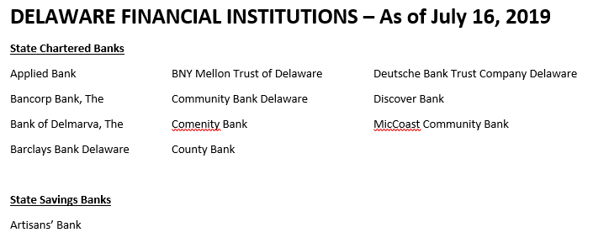

Slide 15
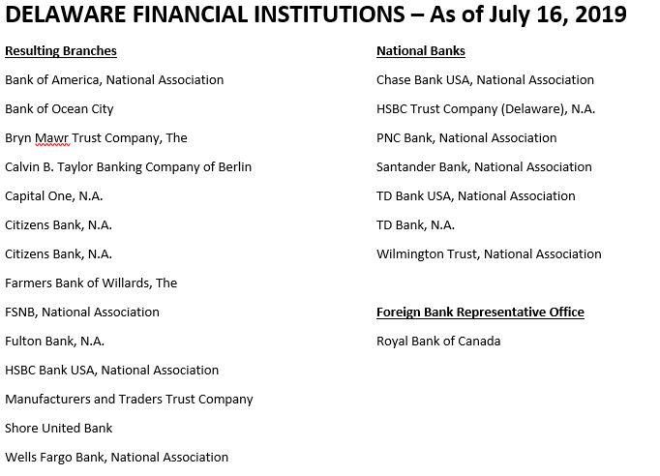

Slide 16
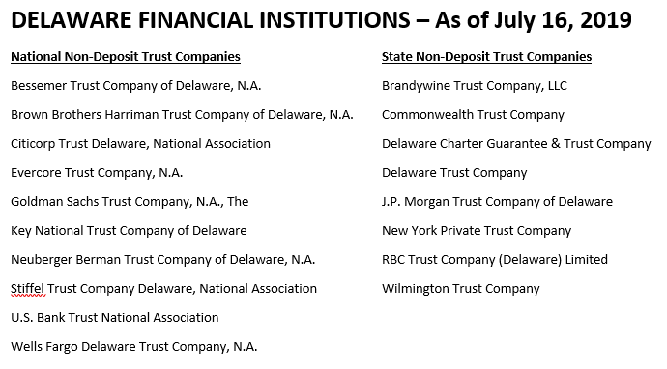

Slide 17
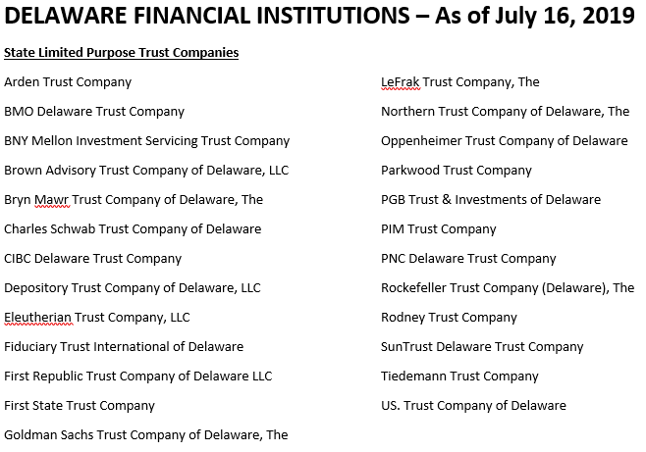

Slide 18
Moving and Modifying Trusts
Goal: Modernize Trust or Minimize State Taxes
Decanting
Merger
NJSA
Court Petition
Appointment of Successor Fiduciaries

Slide 19
QUESTIONS

